Slide 1
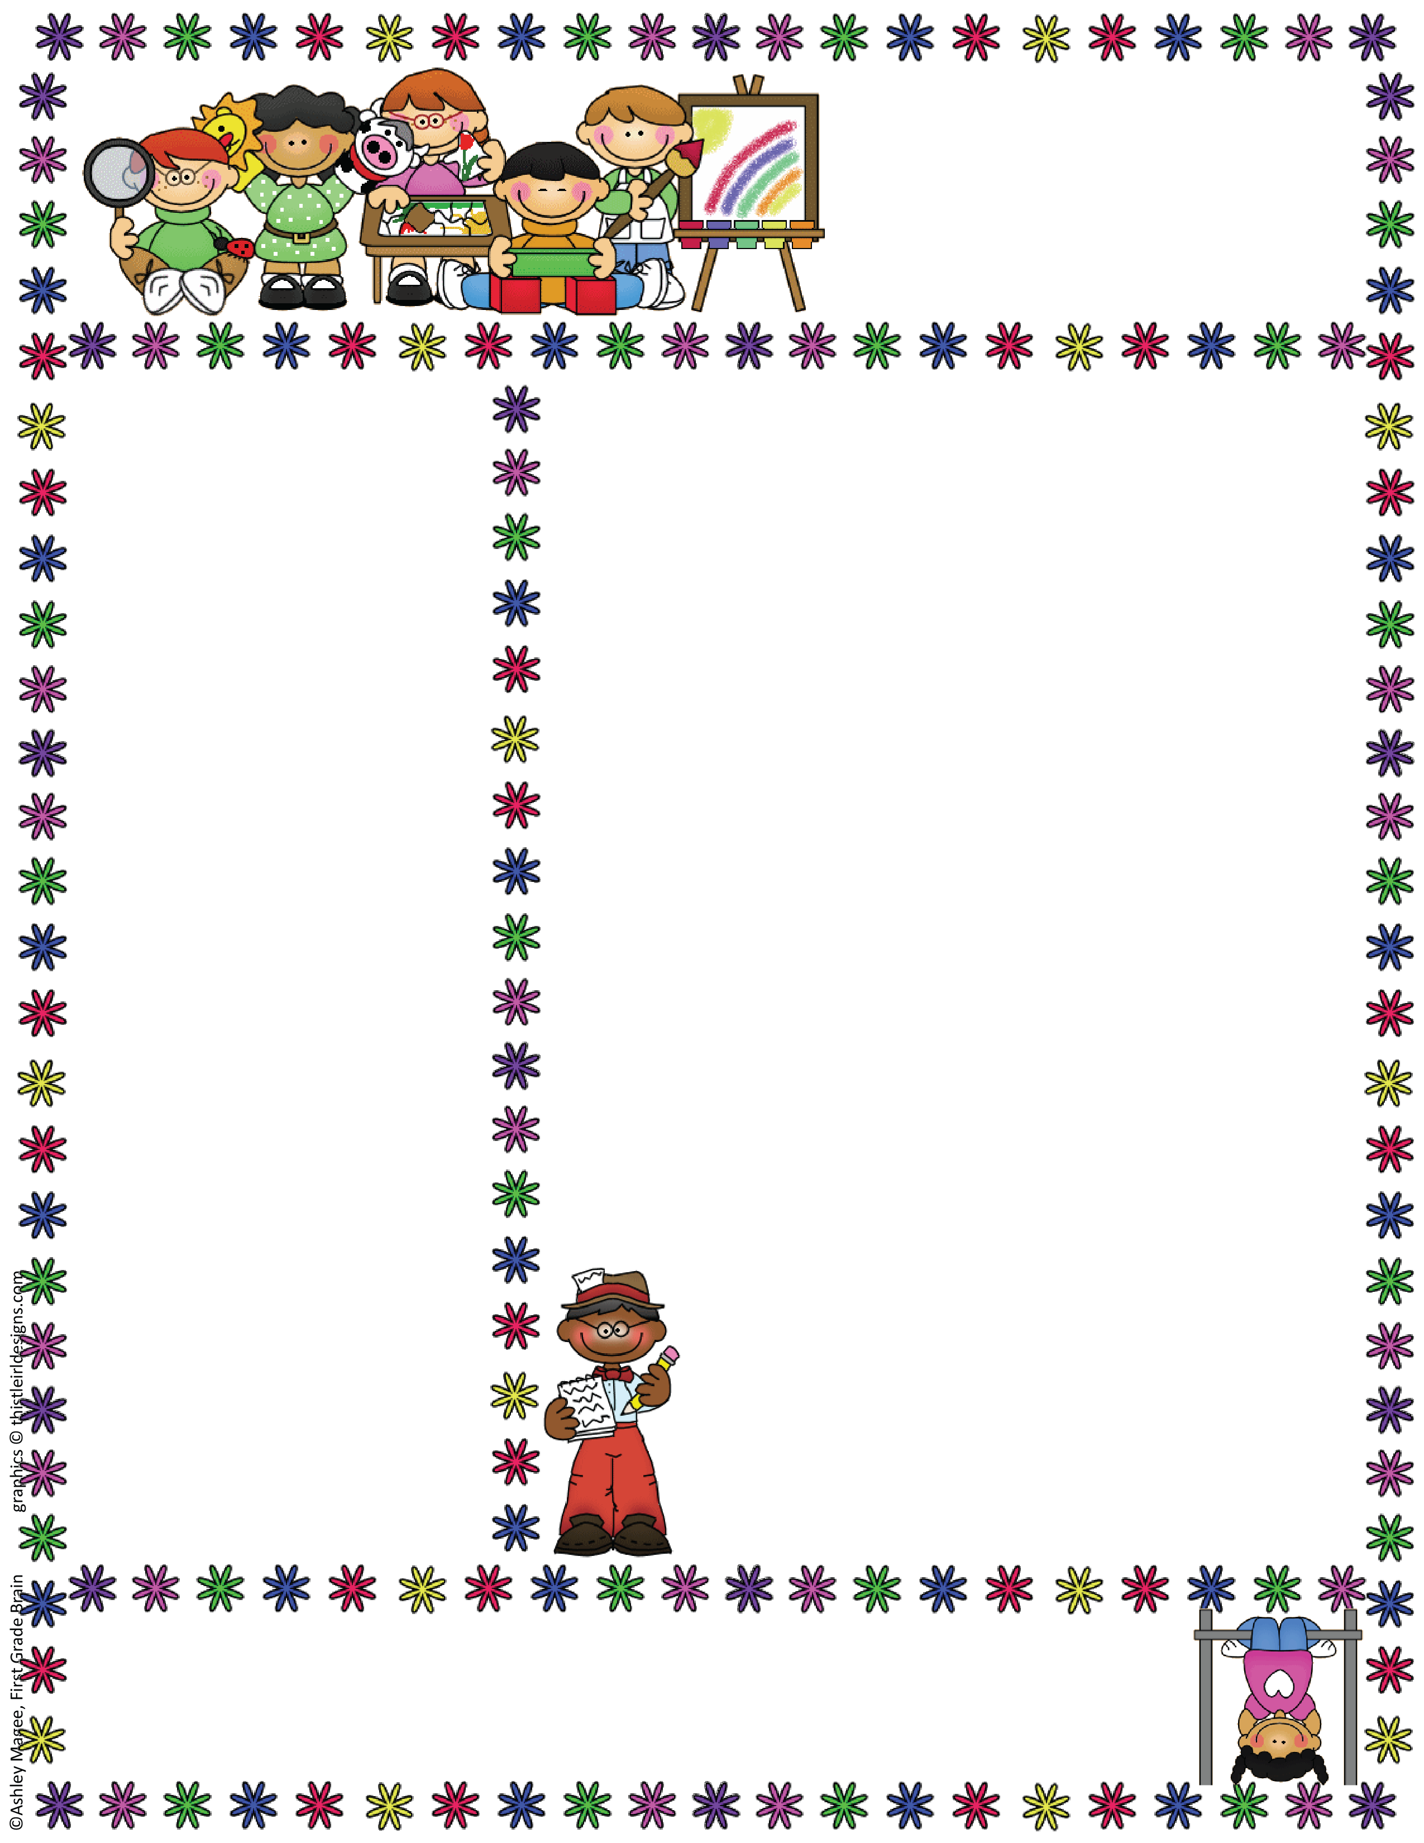
Miss Mayer’s Class
Classroom Newsletter
Sept. 14, 2018
Dates to Remember
September Birthday’s
Sept. 23rd Hailey
Sept. 20- Picture day
Sept. 28- Early Release at 12:00
Oct. 5- Field Trip to Carpenters Nature Center
Oct. 10, 11, 15- Evening Conferences
Oct. 16, 17, 22, 23- Mrs. Brucker will be gone
Oct. 17- No school
Oct 18 & 19- No school
Themes:
Sept. 24- bus safety
Oct. 1- Apples
Oct. 8- Fire Safety
Classroom News
Hello Families,
It has been so fun watching the students improve each day on their classroom routine and expectations. They are beginning to get a hang of our classroom rules.
This week, we started working on handwriting skills, literacy centers, numbers, reading books by looking at pictures, math work stations. The kids are doing a great job.
In your child’s mailbox today, you will see the September Learning Goals. Please take a minute to read over what your child should know by the end of September. There are many resources in the packet to utilize to support your child’s learning at home. This packet is yours to keep. I will not need anything back. At the end of the month, you will see an assessment going home showing what your child knows. If you have any questions, please let me know!!
Next week Thursday, is picture day. Kindergarten students will go right away in the morning. If you are planning on ordering anything, please fill out
the form in your child’s mailbox and send it
back to school!!
Have a great weekend everyone
Miss Mayer Email address: smayer@hastings.k12.mn.us
Kennedy Elementary School
Room 118 Phone Number: 480-7241

Slide 2
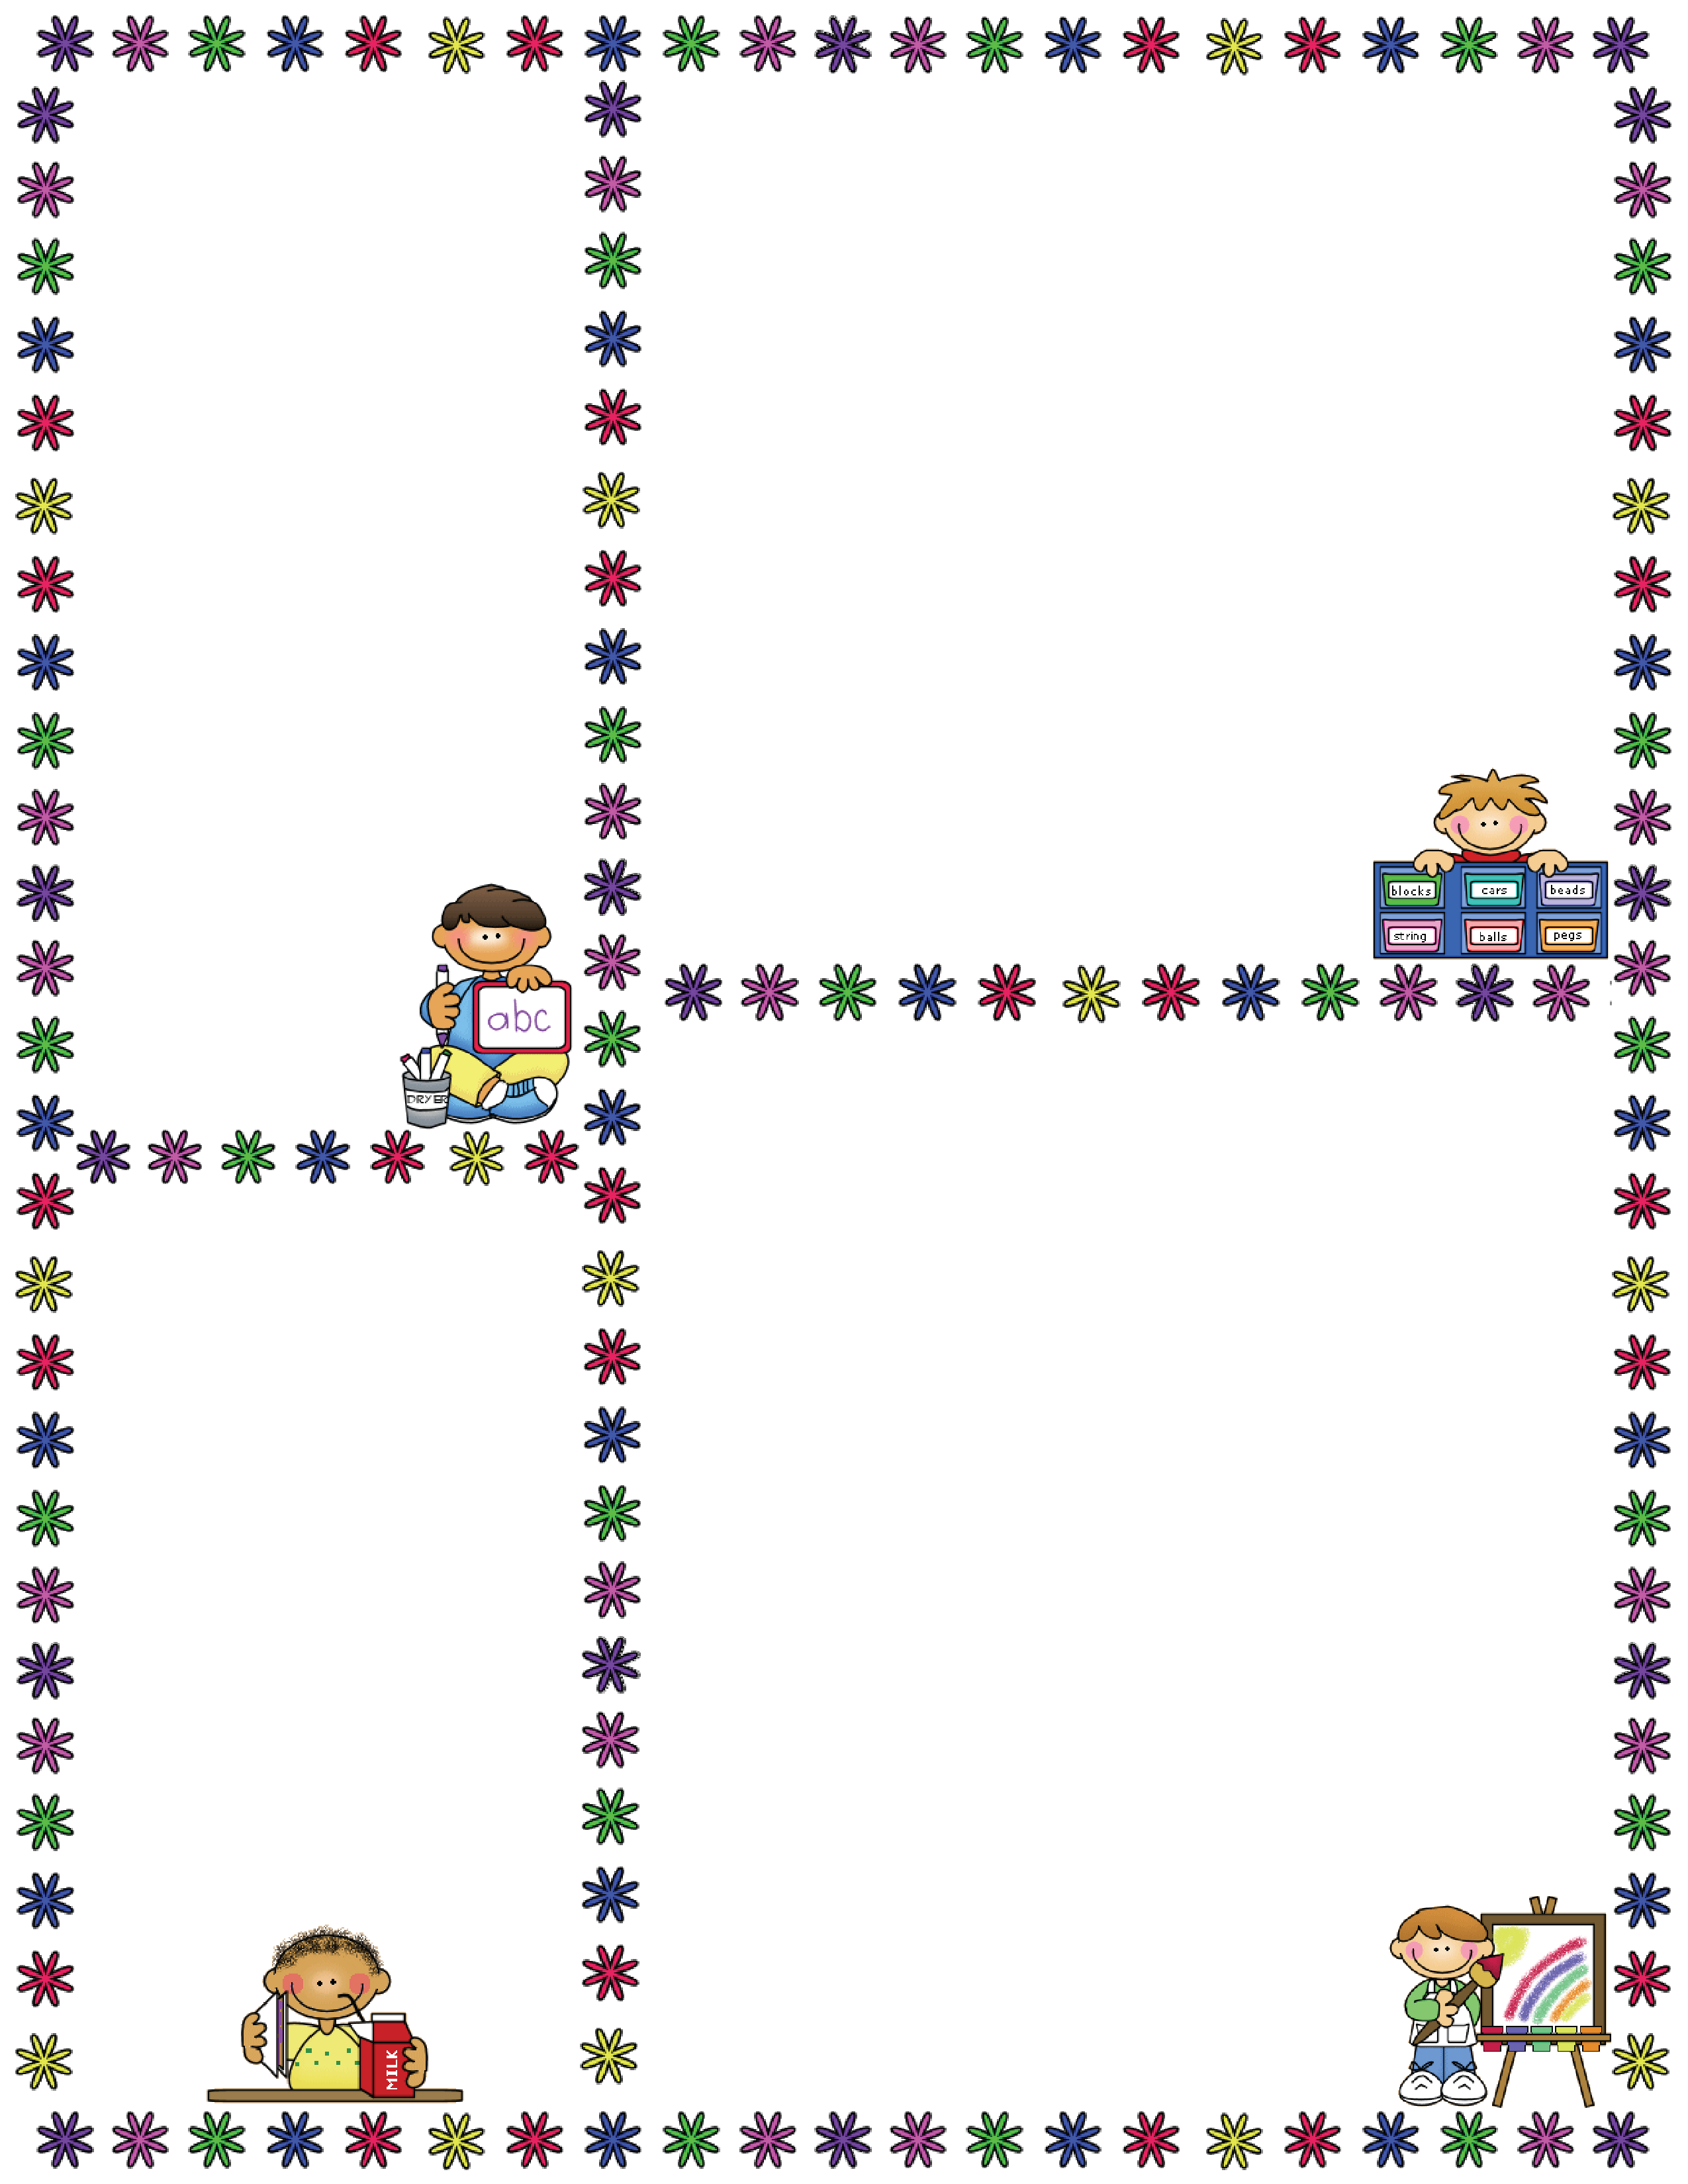
Sight Words
Each week we will have 2 kindergarten sight words. These words are words that we expect students to read and write. Please help your child work on them every night so he/she does not fall behind. There are many great resources out there to help reinforce sight words!
I
Can
What We’re Learning Next Week
Reading: Reading Community, How to read a book, Why do we read?, Reading together
Book: If You Give A Mouse A Cookie
Vocabulary: exhausted, energetic, nuisance, generous
Writing/Handwriting: Dd, Cc, Ee, Ff, Gg
Math: Numbers 1-5
Sight Words: I, can
Theme: Shapes
Specialists Schedule for the week
Monday-Art
Tuesday-Music/Gym
Wednesday-Computer Lab
Thursday-Music/Gym
Friday- Art
Lunch Menu
Remember to look at the school website for lunch choices.
If you are not signed up for healthy snack, please make sure to send a snack with your child EVERY DAY!!

